Slide 1

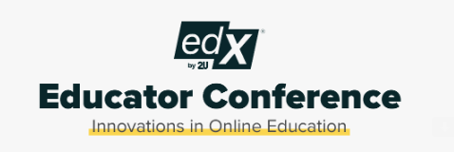
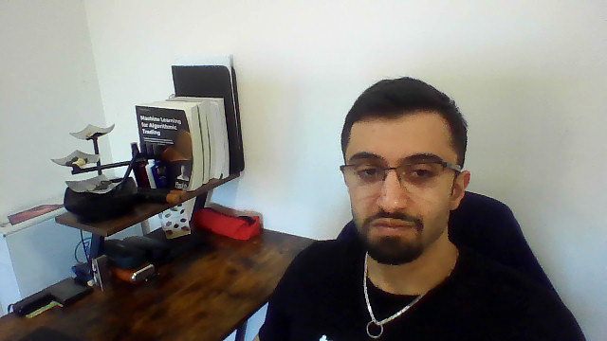
Engaging Tech Students Past Traditional Hands On Educator Conference 2023
✨
Firas Obeid, MS
Data Scientist – UC Berkely FinTech Instructor

Slide 2

Seminar Core Track
The quest to keep the flame of learning burning bright.
Explore innovative instructional strategies, student motivation techniques,
Personalized learning approaches that ignite curiosity and drive student engagement.
Engagement technique for out of the box exploration
✨

Slide 3
A tree of tech teaching Innovations
✨
├───0_Educational-WebApp
├───1_Competitions
│ ├───1_Coding
│ ├───2_TimeSeries
│ └───3_MachineLearning
├───2_IndustryApplications
│ ├───1_DataScienceTooling
│ ├───2_ML-ModelMonitoring
│ └───3_LanguageModel_FinTech (Way before ChatGPT)
└───3_ProjectEngagements
├───Peer_Review_Automation_Email
└───Project_Panel_Judges

Slide 4

0. Innovate your own learning tool

Slide 5

1. Competitions for Competence

Slide 6

2.Learning Beyond the Curriculum

Slide 7
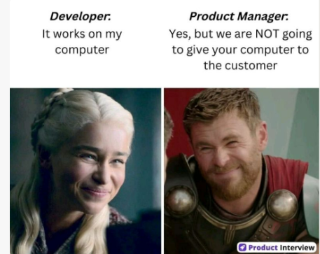
What's next?

Slide 8

3. Prioritize Projects
Created a code script that sends out peer-review templates for each team
Created a code script that sends out Buy/sell Signals via email in class
Invited industry professionals to sit as panel judges and ask questions post project presentations

Slide 9
Seminar's Summary
Throughout my journey at UC Berkley fintech bootcamps for working professionals, I have experimented, adopted and applied the following techniques to engage my students via virtual classes, adapt market trends to reflect practicality off lesson plans and gave hands on real life ML competition or hackathon flavors:
• Invited students from my other cohorts for project showcasing or giving advice at the start of every cohort • Peer self-grading automated email after every project using python scripting
• Initiated 3 competitions during the cohort for extra credits on projects1-3 (all hosted on the web app I created mentioned below): https://lnkd.in/gxSFkyH6 1. Timeseries competition, compete to get the lowest RMSE on test data (tracked on my web app) 2. ML competition (Kaggle style) get best metrics on test data when they upload the predictions on my web app 3. Clean python list of strings without any package ( ranked based on output accuracy and code complexity) 4. Top 3 winners get 10 pts/5pts/2pts on their projects
• Invite mid-career working professionals to contribute to 30% of a project grades and give feedback to the teams
• Showcase the following application, built in previous work settings or side projects: 1. Character level language model for event driven trading (Have been showcasing to every cohort, even before ChatGPT became viral) (https://lnkd.in/e8K849wW) 2. Deploy python panel apps serverless on github using pyodide initiative (web assembly)(https://lnkd.in/e6jQ67zG) 3. Show a mini code running in RUST for mining blockchain 4. Build an artificial trading system that uses monte carlo to fetch random returns in order to simulate buy/sell signals email notifications(39mins out): https://lnkd.in/eatXtetJ • Created a web application where I hosted all the mentioned competitions, extra code snippets and personal lectures material for the students: https://lnkd.in/gxSFkyH6
All resources, code, tools and material can be found at: Github_Repo

